Slide 1
Building Surgical Implants:APT TTP
John Rodriguez
@Cyb3rH0und
CyberDagger LLC

Slide 2


LookUpAccountSid
Over a decade in Cyber Operations
Pioneer in AI/ML for Offensive Development
Instructor
MITRE Evaluations
Capability Engineering
Certified Multiple Operational Red Teams
Threat Emulations
TOO EASY!

Slide 3
Agenda
01
02
Historical Perspective
Offensive Methodology
APTs, Motivations and Victims
Actions, Motivations, Psychology
03
04
Surgical TradeCraft
Implant Dev
Operation Dependent
Modular, Precise and Effective
Notes:
Why are you here? What will you learn

Slide 4
Agenda Cont.
05
AI Pipeline
Buzz, If/Else, Reality

Slide 5

01
History 101: APT
When the path you walk always leads back to yourself, you never get anywhere - Master Oogwway

Slide 6
Historical Perspective(allegedly)
APT-29: Operation Cloud Hopper 2014 through 2017 SolarWinds,Microsoft
APT-41: Cuckoobees - 2019 through 2021. Supply chain vectors, IP theft.
APT-28: Recent Ubiquiti Edge Router botnet

Slide 7
Historical Perspective:TURLA
Sophisticated Command and Control (C2) Infrastructure:
Uses multiple layers of encryption and obfuscation.
Employs compromised infrastructure to relay communications.
Custom Tooling:
Uroburos sophisticated rootkit.
Kuzuar Implant.
Carbon.
Older PowerShell Scripts.
Stealthy Persistence Mechanisms:
Injects malicious code into legitimate processes to evade detection.
Uses rootkit capabilities to maintain long-term access.

Slide 8
02
Methodology 101
Never tell people how to do things. Tell them what to do and they will surprise you with their ingenuity - George S. Patton

Slide 9

Offensive Objective Base Methodology
Long Term Persistence
Destructive Actions
Espionage
Opportunistic
Risk Awareness
Strategic Goals
Synergy

Slide 10
Offensive Objective Base Methodology: Example
BendyBear Shellcode Stage 0:
Polymorphic Code
Position Independent Code
Multi-Layer Encryption
Situational Awareness
DNS Flush
Port 443
Custom Encryption (Just Don’t)
Anti-Forensic Properties

Slide 11
03
Surgical Tradecraft
Do nothing which is of no use - Miyamoto Musashi

Slide 12
Let’s Get Surgical: 5Ds
01
Deceive
False Flag
Deceptive Data
Honey Nets
Spoofing
02
Degrade
Operational Efficacy
Data Pollution
Communications
03
Deny
Deny a Capability
Command and Control
04
Disrupt
Capabilities
Disable Operation Readiness
05
Destroy
Critical Data
Physical Destruction

Slide 13
Let’s Get Surgical: 5Ds
01
Operational Objective
Deceive, Degrade, Deny, Disrupt, Destroy
Gather Information
LSASS Dump
Exfil Loot
02
Risks
Matured Environment
EndPoint Protections
On-Disk Artifacts
03
Development
Exploit DLL Sideload
Evasive DLL
Minimal Attribution
04
Testing
Unit Testing
Offline Testing
Online Testing
05
Deployment
Target Foothold
Longevity
Operational Success

Slide 14
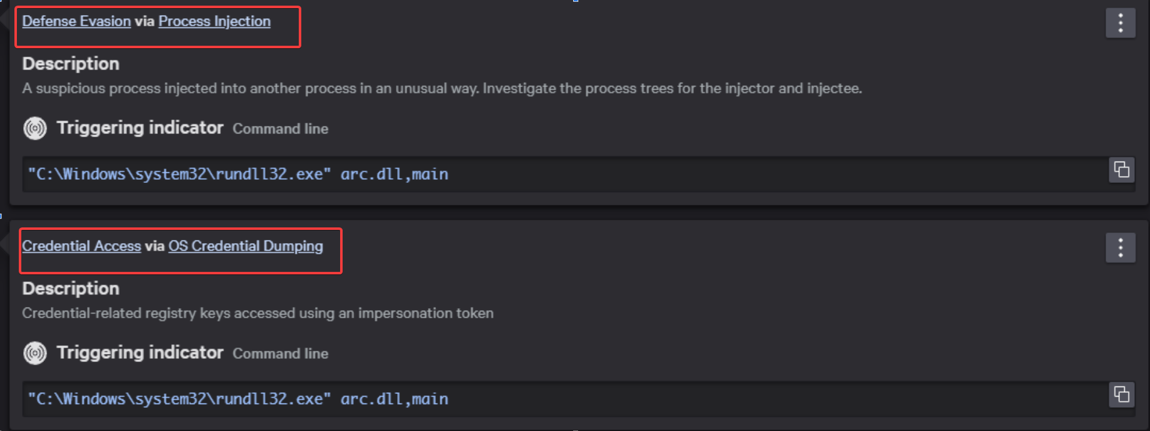
Operational Risk: Environment
Notes:
Proces Injection is risky

Slide 15
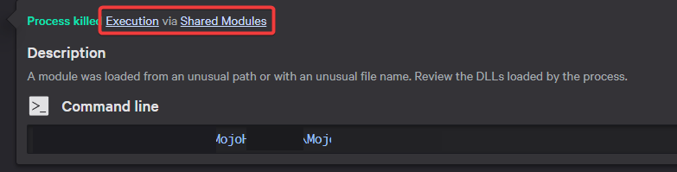
Operational Risk: Environment
Understanding Detections
Detection Engineering

Slide 16
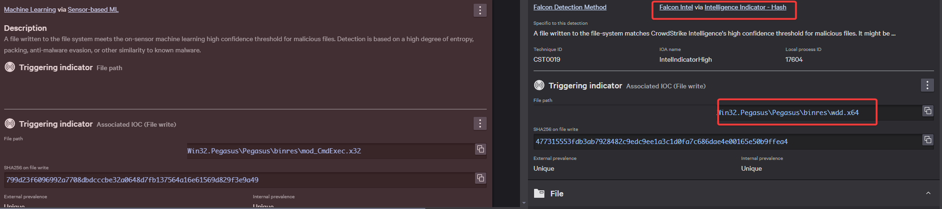
Operational Risk: Environment

Slide 17
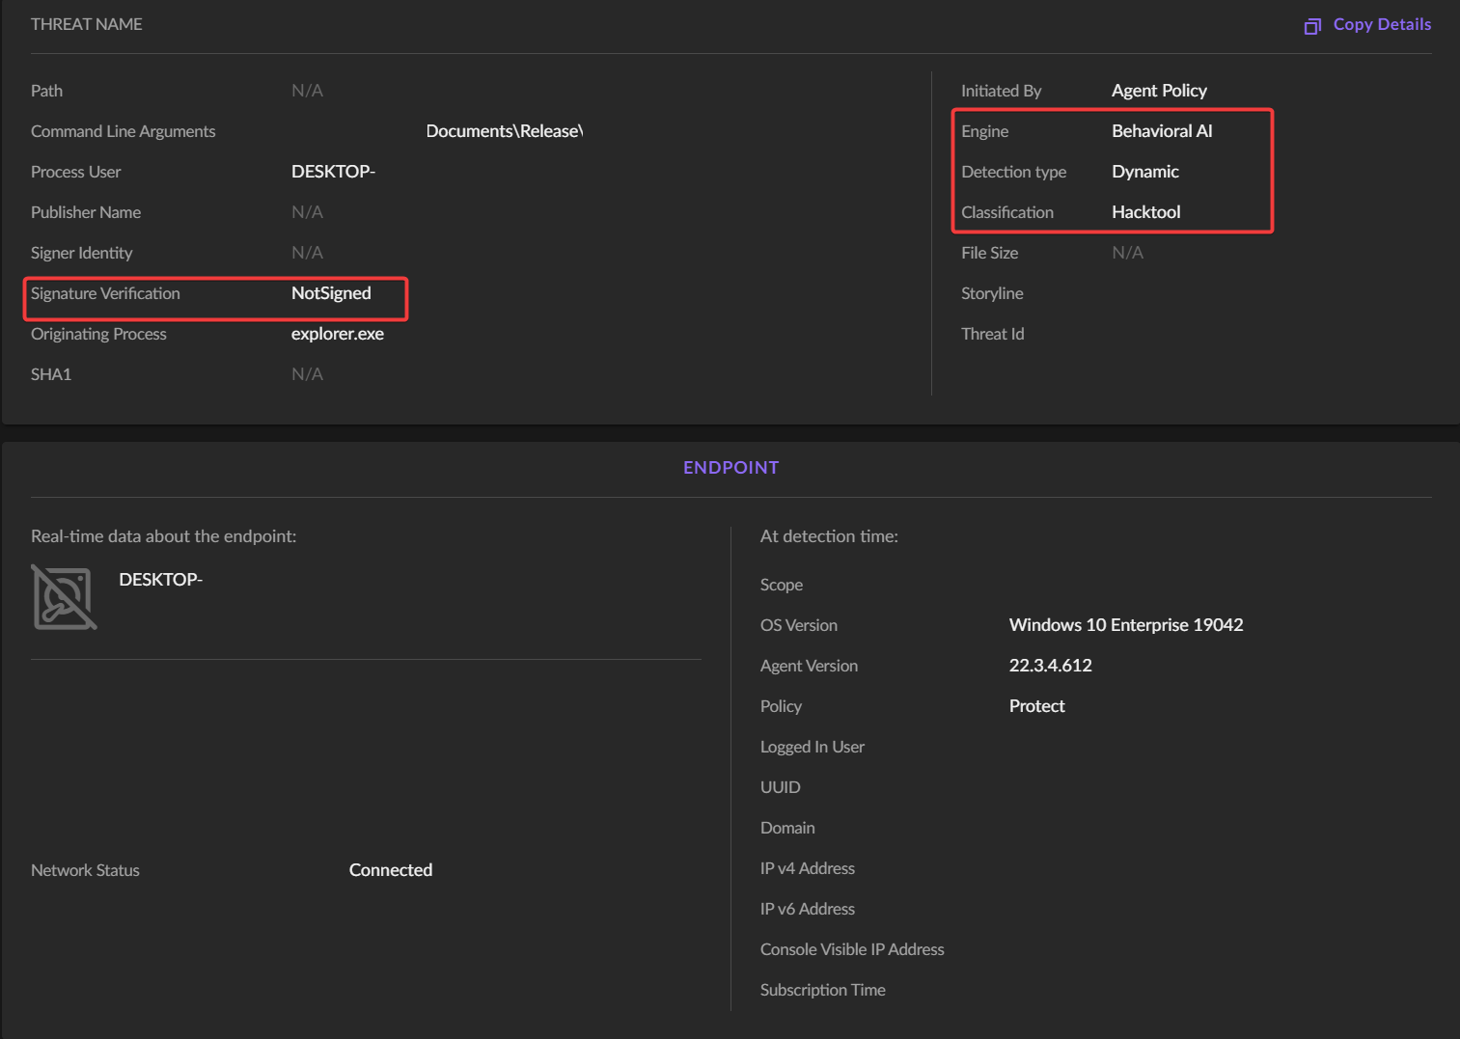
Operational Risk: Environment
Unsigned
Dynamic Detection
Heuristics

Slide 18
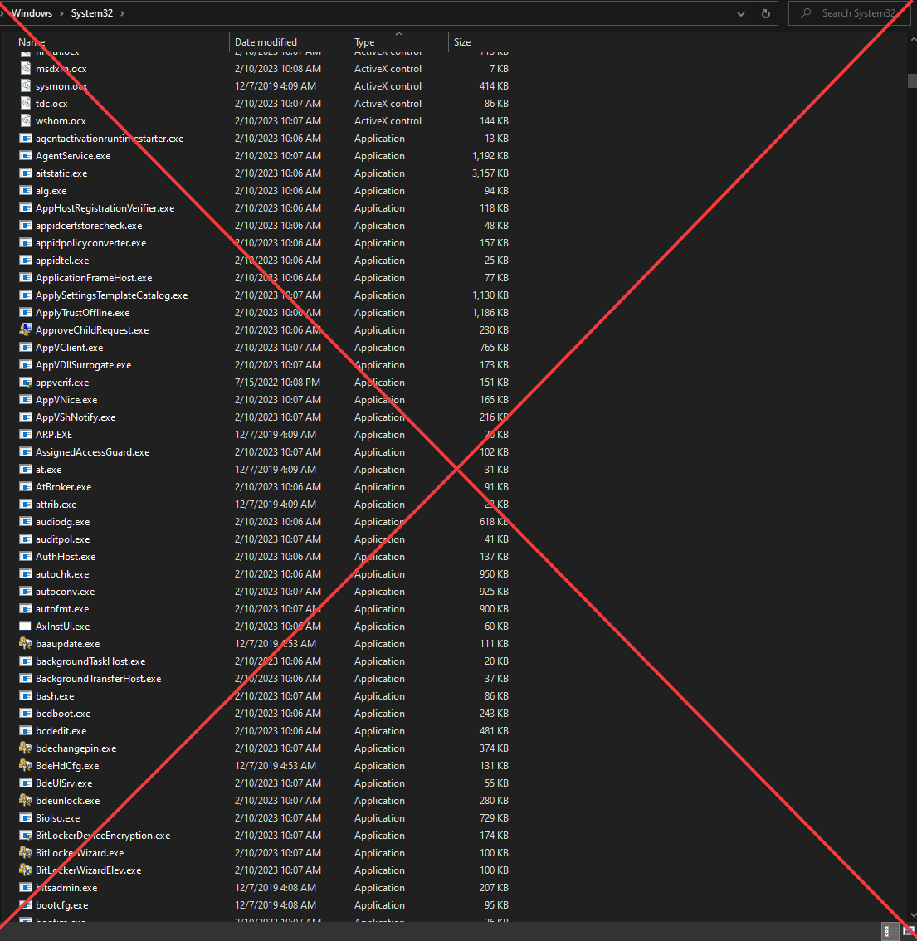
Operational Risk: Environment
System32 = Burned
Heavily Signatured

Slide 19
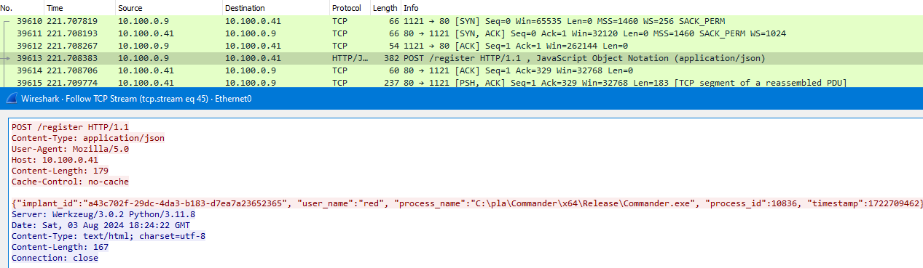
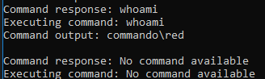
Operational Risk: Network

Slide 20
04
Implant Development
About Time: ME

Slide 21
Design Phase: 75-85
Survivability
Objective
Core
Validate environment
Anti-Forensics
Anti-Debug
Defense Evasion
Blending
Kill-Switch
Kill-Date
Data Collection
Execution
AI Pipeline
Compile-Time Hashing
Secure Network
Obfuscation
Deception
Notes:
Code should write it self from the design - Ken Dividing line between HAXOR and Operators

Slide 22
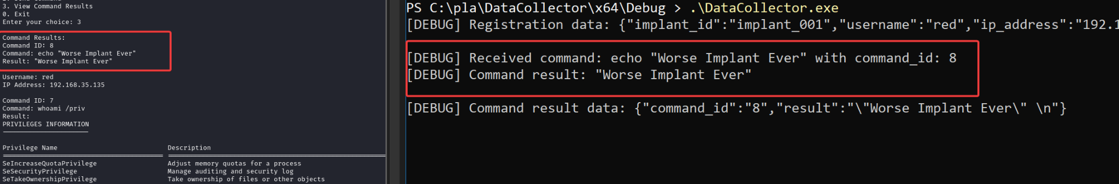
Survivability: 0.9999%

Slide 23
Survivability: 0.9999%

Slide 24
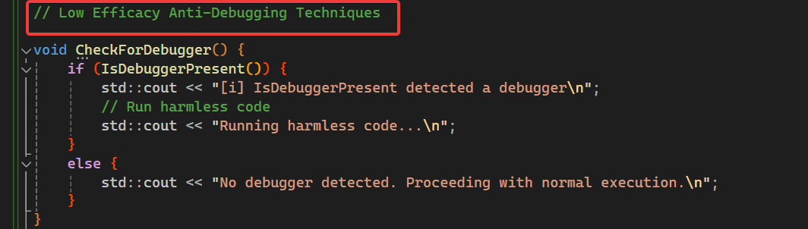
Design Phase:Anti-Forensics
Code Obfuscation
CRT Independent
API Hashing
Control Flow Obfuscation
Check for Debugger
Notes:
Suspicious WINAPI

Slide 25
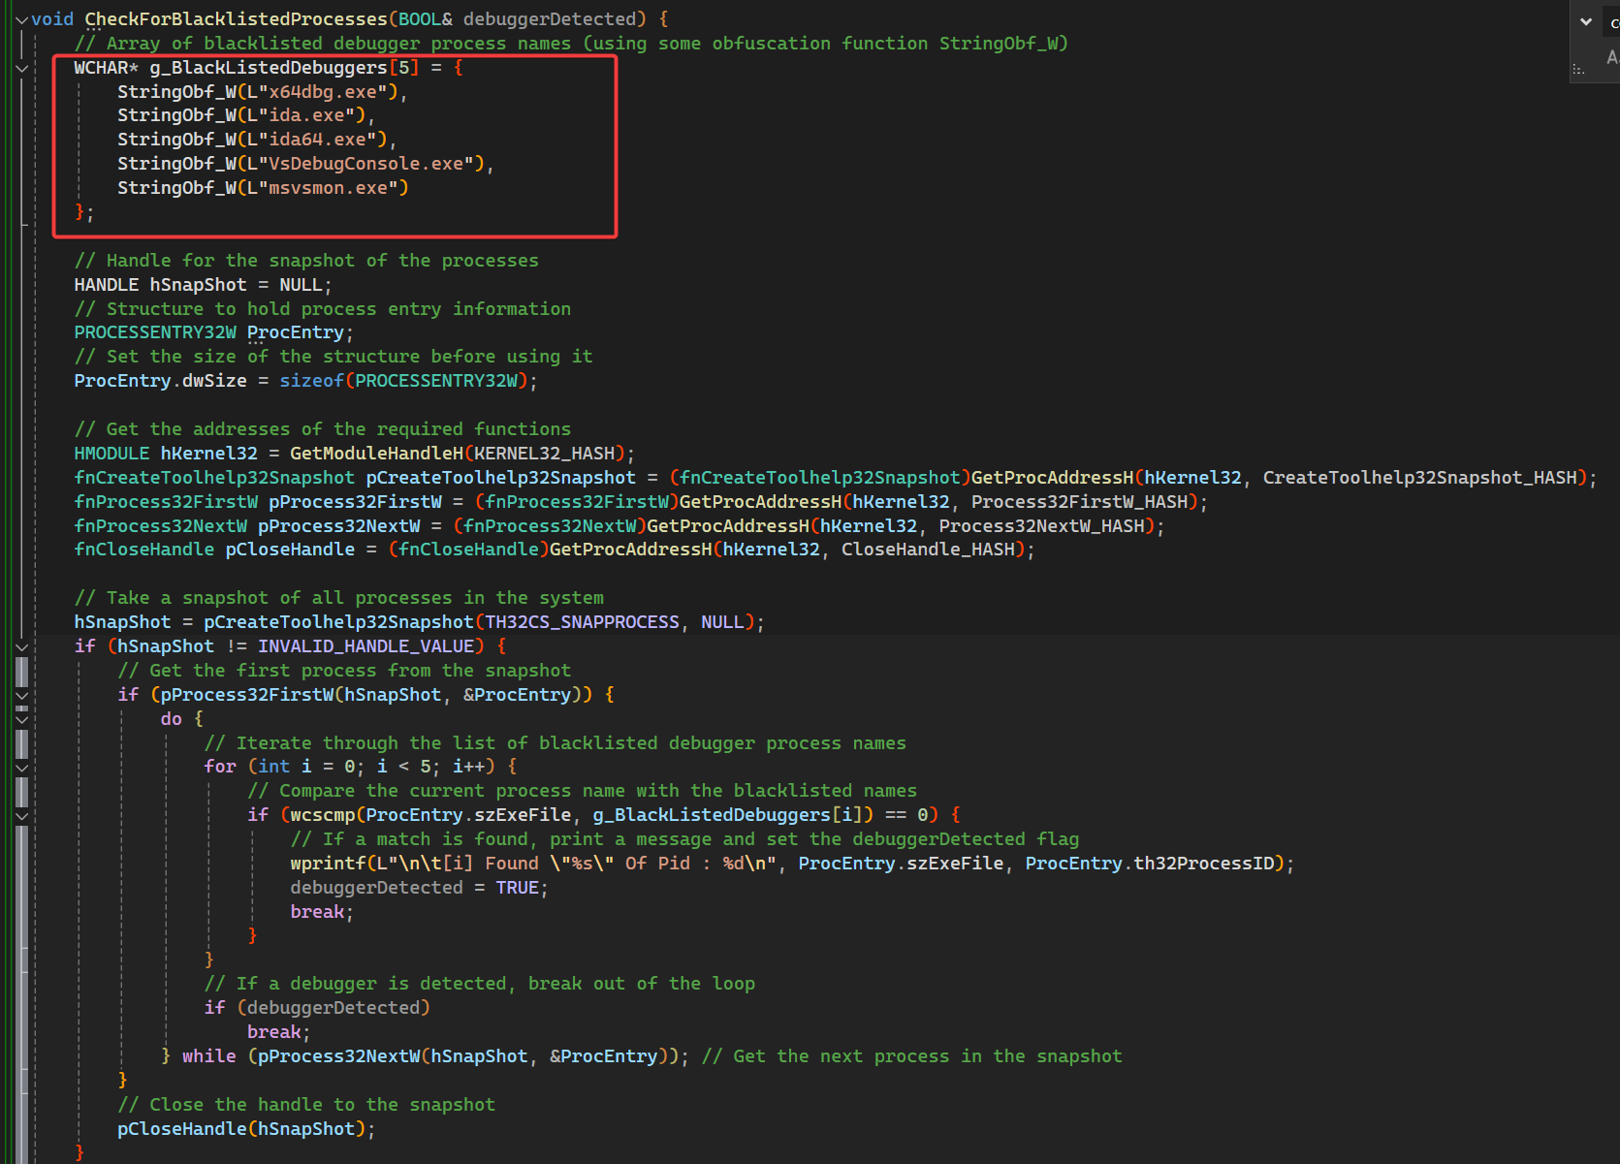
Survivability:Anti-Forensics
Semi-Affective
Notes:
Suspicious WINAPI

Slide 26
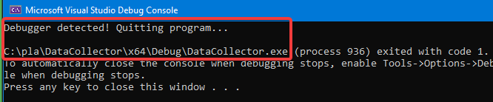
Survivability:Anti-Forensics
Notes:
Languages by what we teaching. AI segway! Slide to show VXUnderground - Measure of surprise HIGH entropy hard to figure out structure of msg/ Low - deterministic providing randomness to enc flatten cr

Slide 27
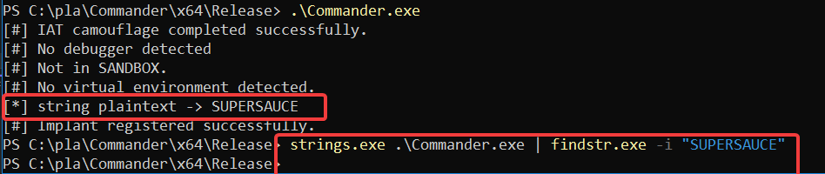
Survivability:Compile-Time Hashing

Slide 28
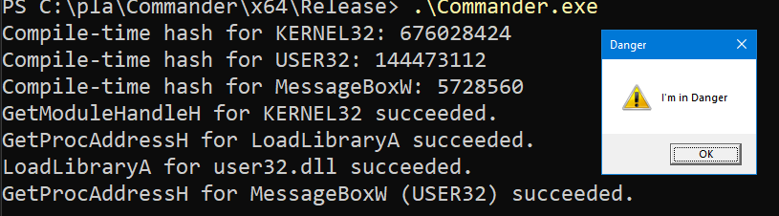
Survivability:Compile-Time Hashing

Slide 29
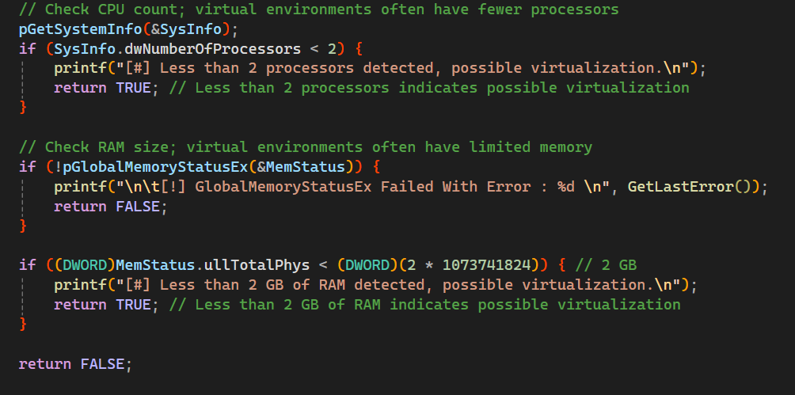
Anti-Forensics: Sandbox
Notes:
Languages by what we teaching. AI segway! Slide to show VXUnderground - Measure of surprise HIGH entropy hard to figure out structure of msg/ Low - deterministic providing randomness to enc flatten cr

Slide 30
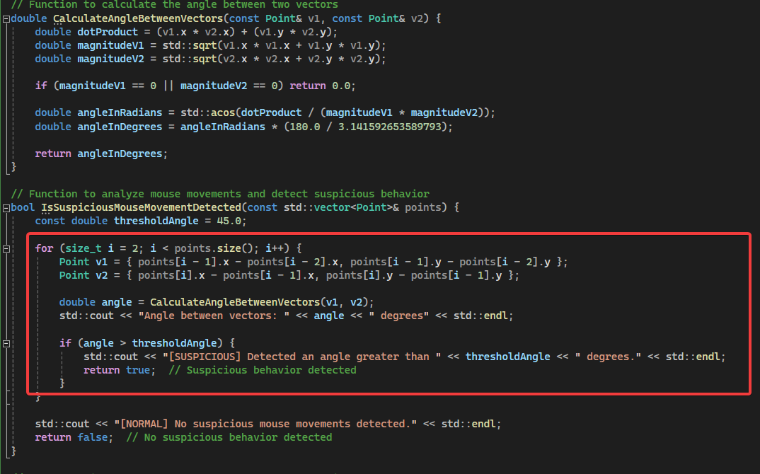
Anti-Forensics: A Dash of Math
Capture “USER” movement
Probability base
May miss target
Notes:
Mouse Movement/Vector angles

Slide 31
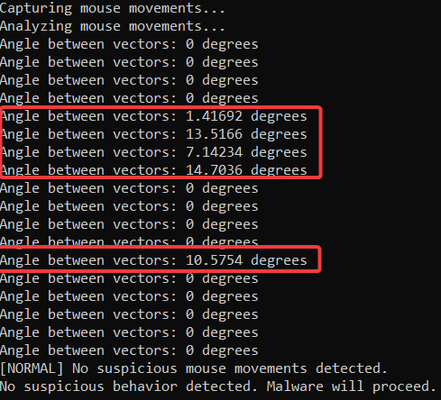
Anti-Forensics: A Dash of Math
There are countermeasures.
Notes:
Mouse Movement/Vector angles

Slide 32
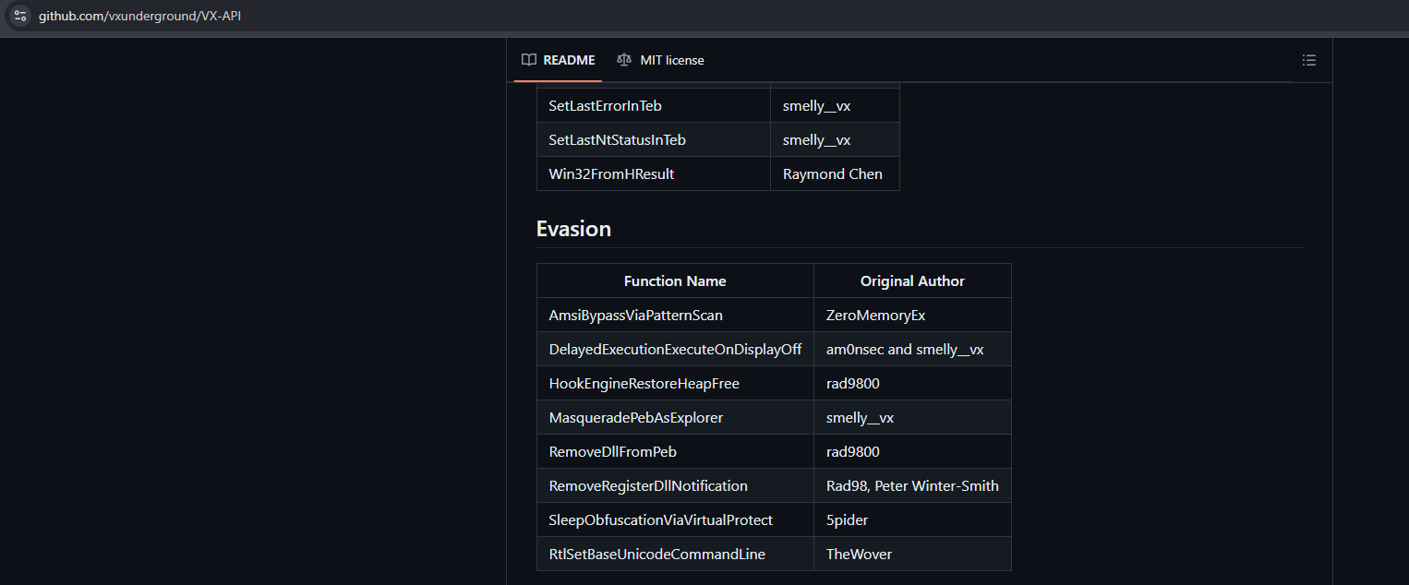
Anti-Forensics: Custom API
Notes:
Languages by what we teaching. AI segway! Slide to show VXUnderground - Measure of surprise HIGH entropy hard to figure out structure of msg/ Low - deterministic providing randomness to enc flatten cr

Slide 33
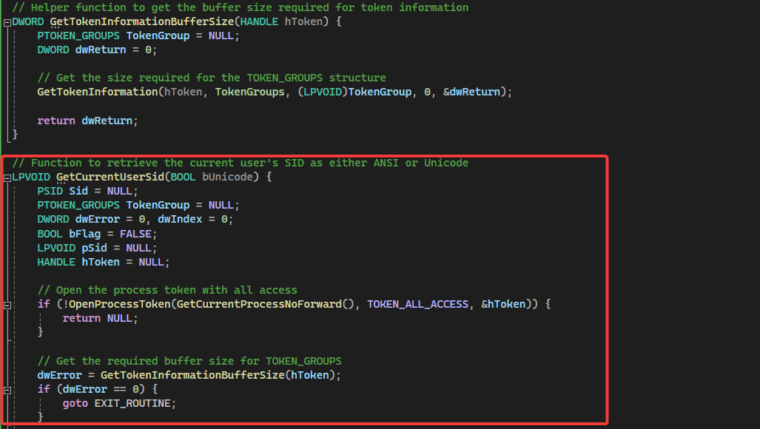
Anti-Forensics: Custom API
Notes:
Languages by what we teaching. AI segway! Slide to show VXUnderground - Measure of surprise HIGH entropy hard to figure out structure of msg/ Low - deterministic providing randomness to enc flatten cr

Slide 34
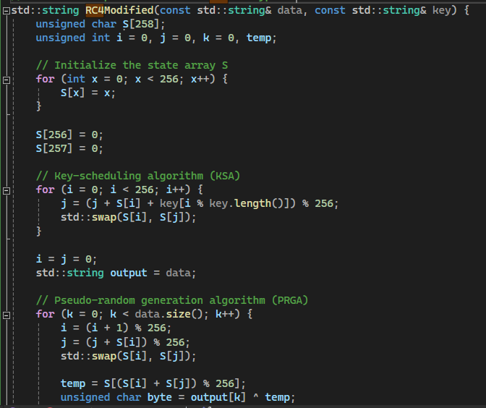
Anti-Forensics: Custom Encryption
Variation of RC4
Similar to BendyBear
Additional XOR is performed
S[(S[k] + S[(i + j) % 256]) % 256]
Increases complexity
Notes:
Languages by what we teaching. AI segway! Slide to show VXUnderground - Measure of surprise HIGH entropy hard to figure out structure of msg/ Low - deterministic providing randomness to enc flatten cr

Slide 35
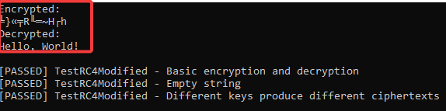
Anti-Forensics: Custom Encryption
Commercial C2
NEVER roll your own crypto
Notes:
Languages by what we teaching. AI segway! Slide to show VXUnderground - Measure of surprise HIGH entropy hard to figure out structure of msg/ Low - deterministic providing randomness to enc flatten cr

Slide 36
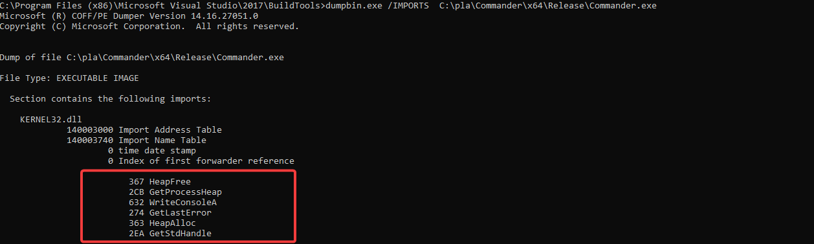
Survivability:Benign API

Slide 37
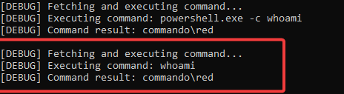
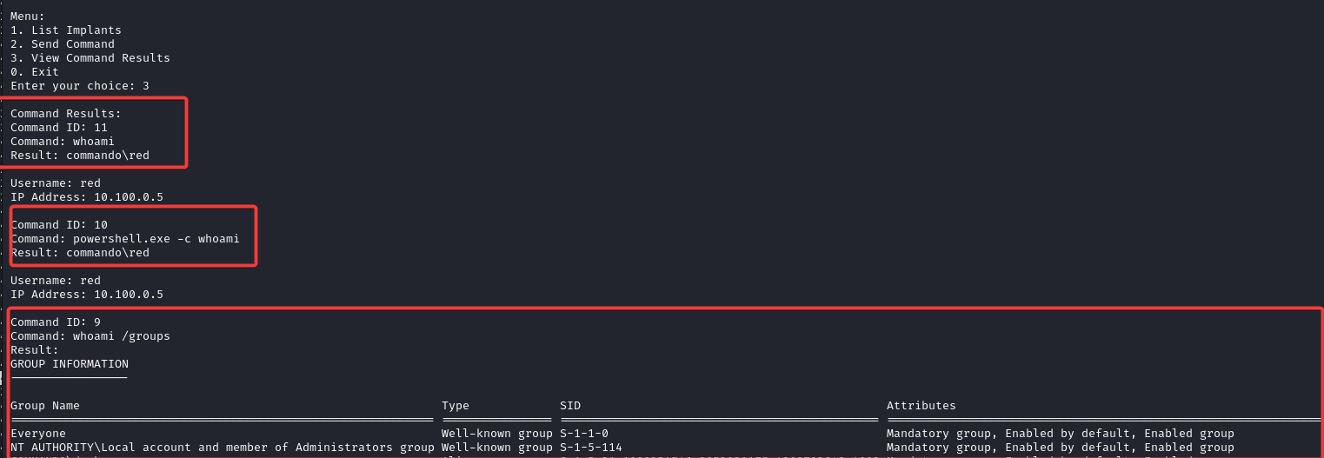
Development: Modularity & Testing
Notes:
Languages by what we teaching. AI segway! Slide to show VXUnderground - Measure of surprise HIGH entropy hard to figure out structure of msg/ Low - deterministic providing randomness to enc flatten cr

Slide 38
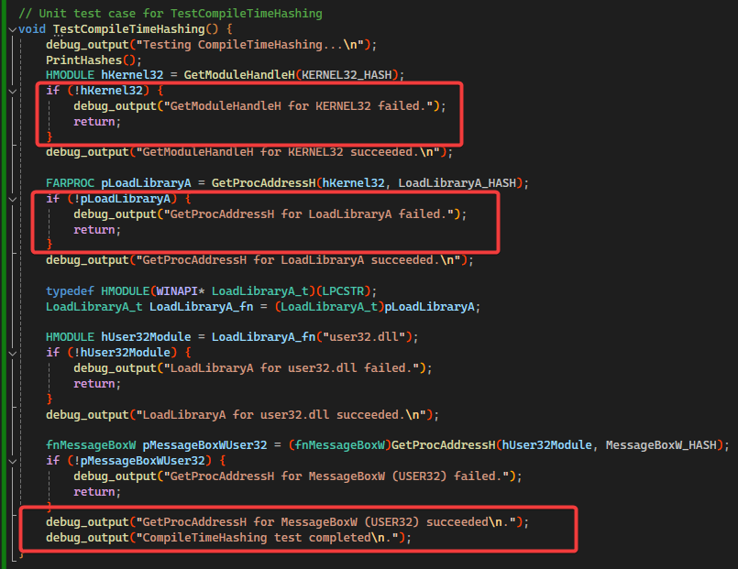
Development: Modularity & Testing

Slide 39
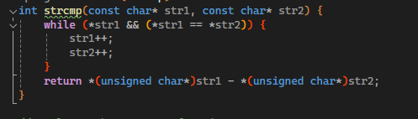
Development: Granular Control
Replace CRT functions
Keep size small
Less API Overhead

Slide 40
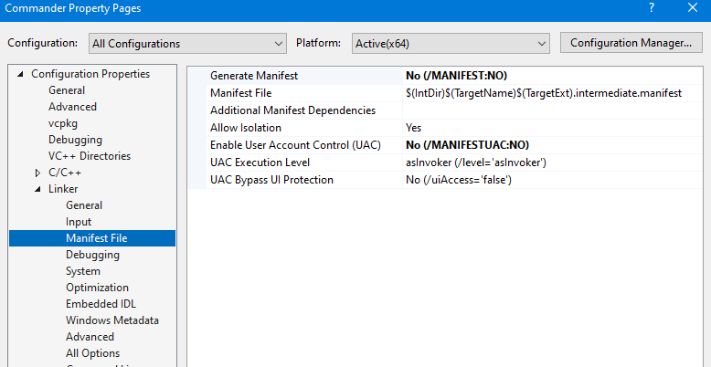
Development: Size Matters-ish

Slide 41
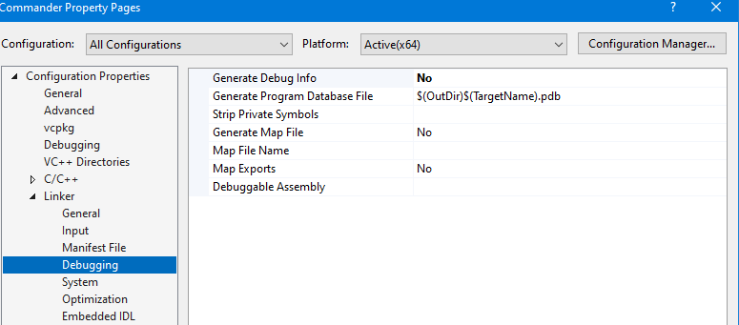
Development: Debug without Debug

Slide 42
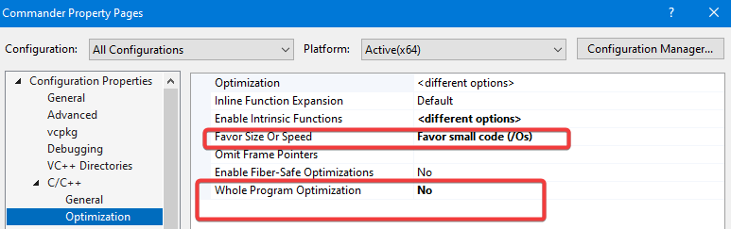
Development: Granular Control
Granularity for deployment matters

Slide 43
Advanced Topics
R&D
HellsHalls - Userland Indirect Syscalls
Spoof Stack Tracing
Double DLL Sideloading
Kernel Exploitation
Exploiting EDR/XDR
CRT Independent
Sentinel One Unhooking Detections
Notes:
Exercise left to the reader

Slide 44
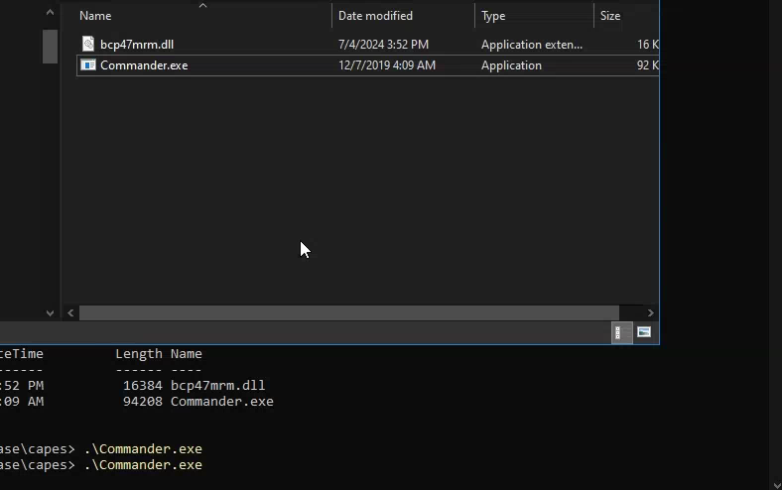
Capability Showcase
Silly Goose It!
Notes:
Exercise left to the reader

Slide 45
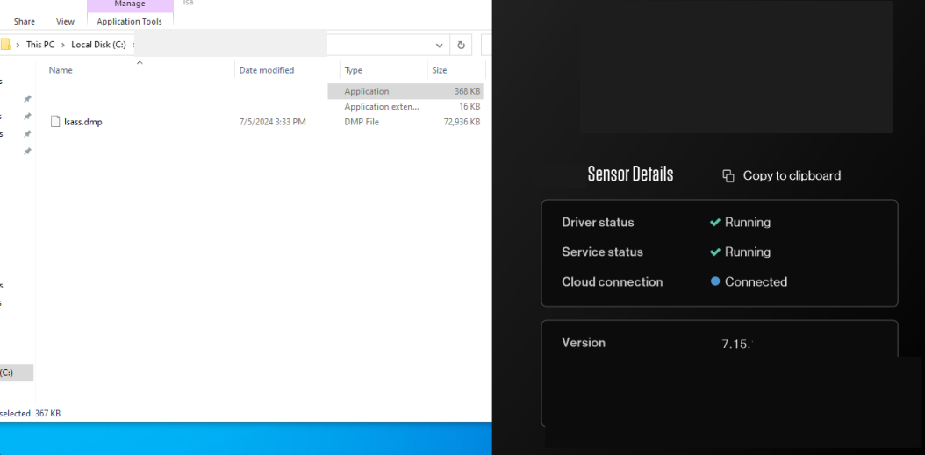
Capability Showcase
Silly Goose It!
How careless can you be?
Notes:
Exercise left to the reader

Slide 46
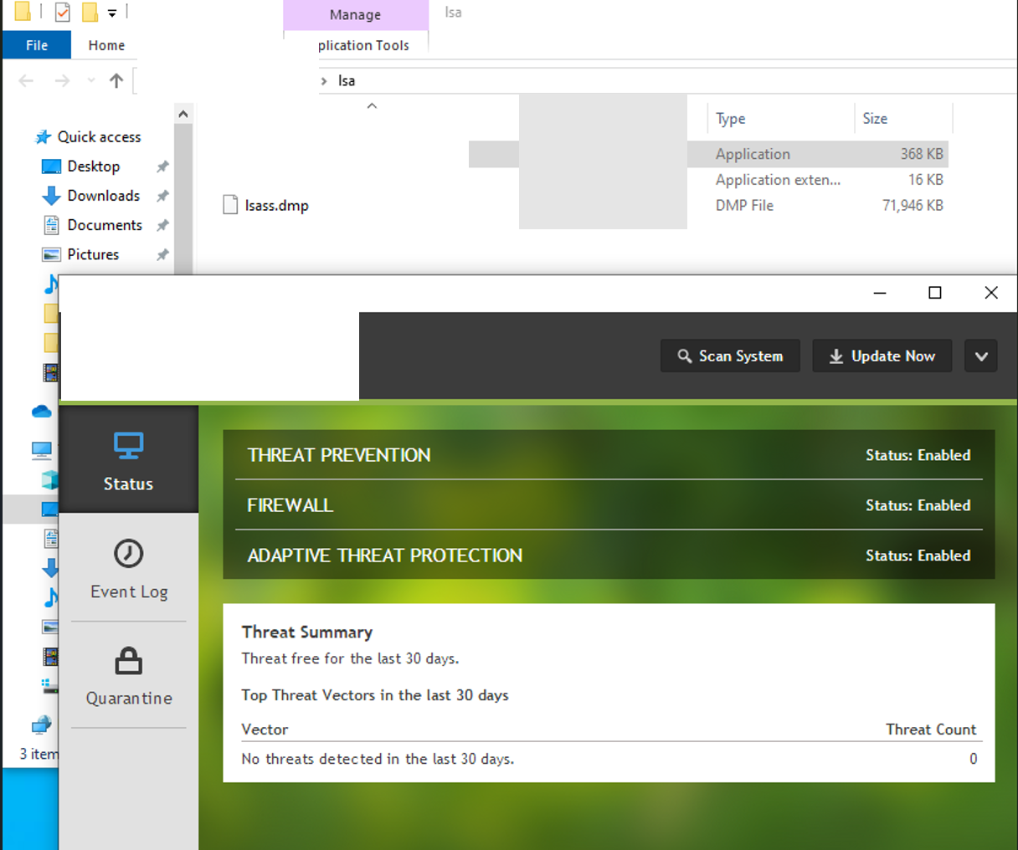
Capability Showcase
Silly Goose It!
Do you even lift?!
No really….
Notes:
Exercise left to the reader

Slide 47
05
AI Integration
Red Reaper

Slide 48
AI Integration:BUZZ-BULL OR BUZZ-ISH
Data Collection
Fine-Tune
Terabytes
Petabytes
Hugging Face
OpenAI
Hardware Cost
Realistic
GPU GPU GPU GPU
STORAG
To SKYNET or Not to SKYNET
Notes:
What GPT lacks, you can easily deploy offline and fine-tune.

Slide 49
AI Integration:BUZZ-BULL
Confidentiality
Fine-Tune
Red Team Clients
Privilege Information
Long Term Cost
Model Selection
Costs
Realistic
Data Preparation
100,000 Data Points
10 Million tokens
Results Vary
Notes:
What GPT lacks, you can easily deploy offline and fine-tune. 30k

Slide 50
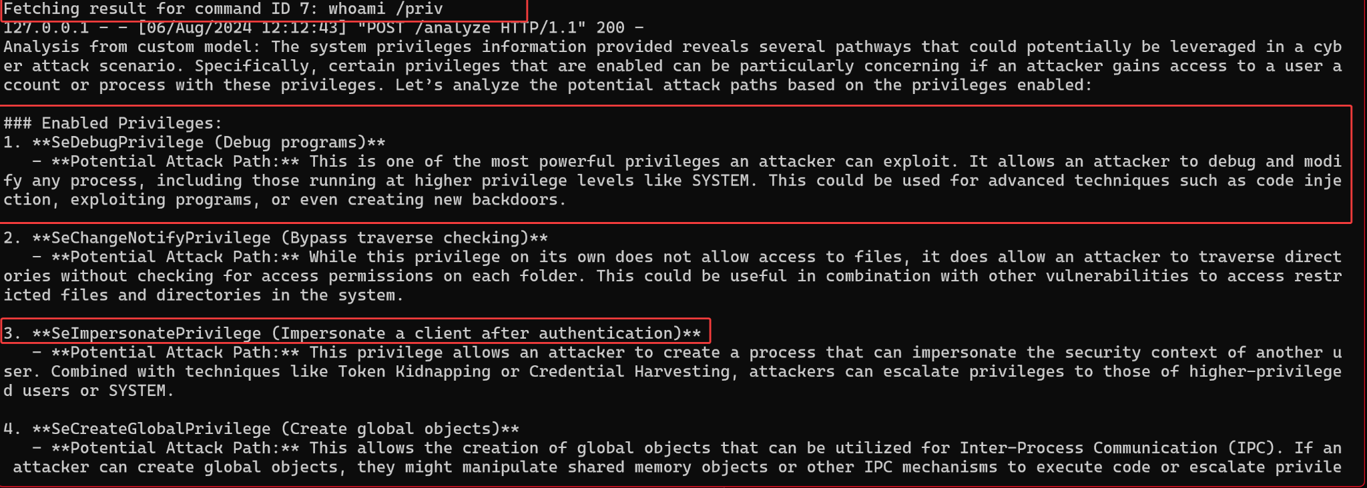
AI Integration: BUZZ-ISH
Notes:
What GPT lacks, you can easily deploy offline and fine-tune.

Slide 51
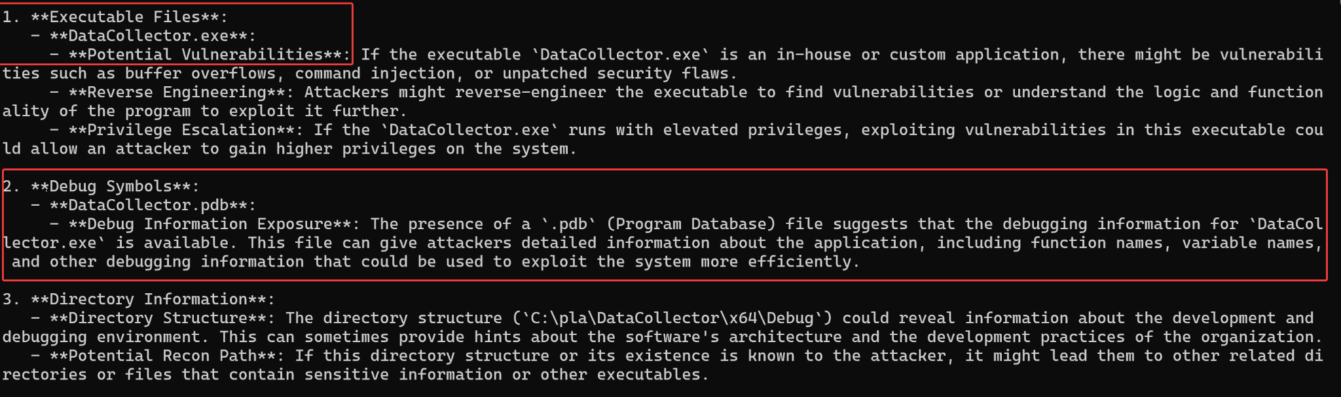
AI Integration: BUZZ-ISH
Notes:
Quick analysis of data

Slide 52
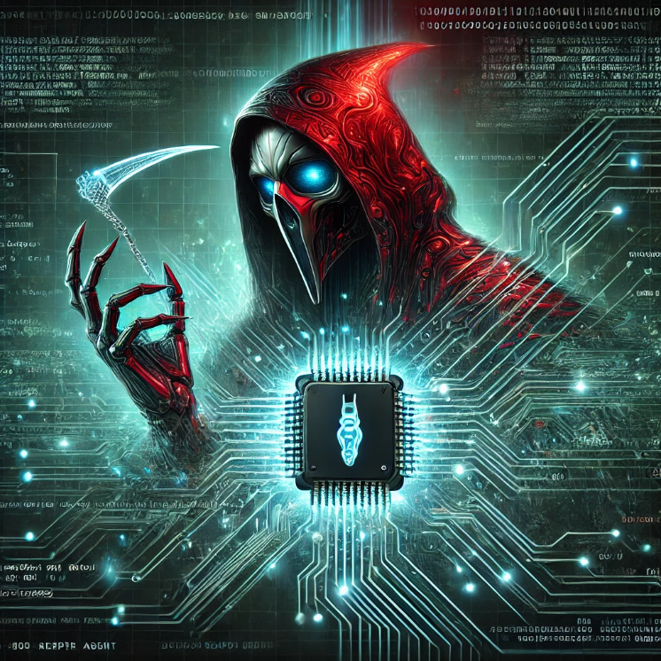
AI Integration: Red Reaper
Notes:
Quick analysis of data using NER

Slide 53
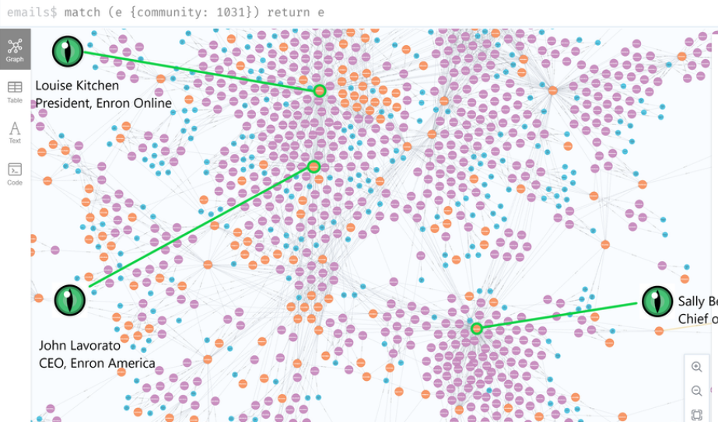
AI Integration: BUZZ-ISH
ENRON email corpus
Named Entity Recognition
Generative AI LLM
AI enabled espionage and warfare
Nation State Capabilities
Notes:
Quick analysis of data using NER

Slide 54
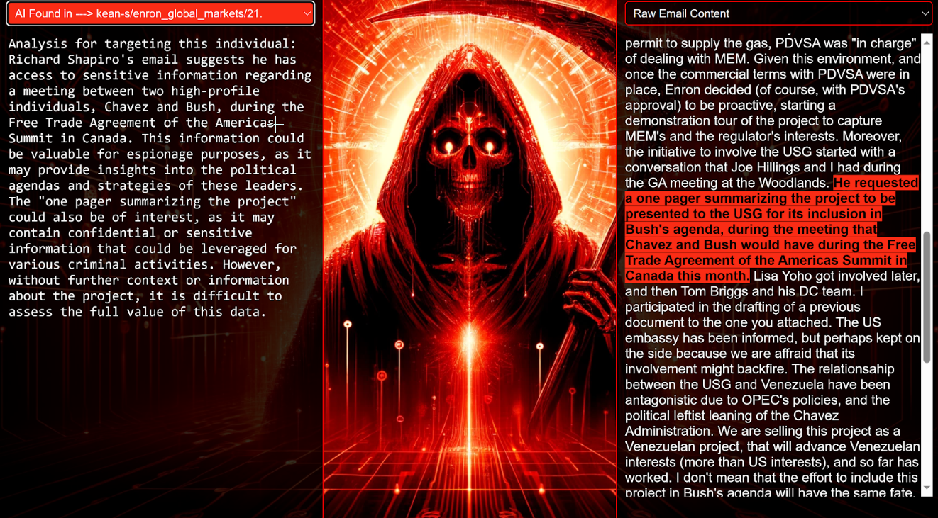
AI Integration: BUZZ-ISH
Notes:
Quick analysis of data

Slide 55
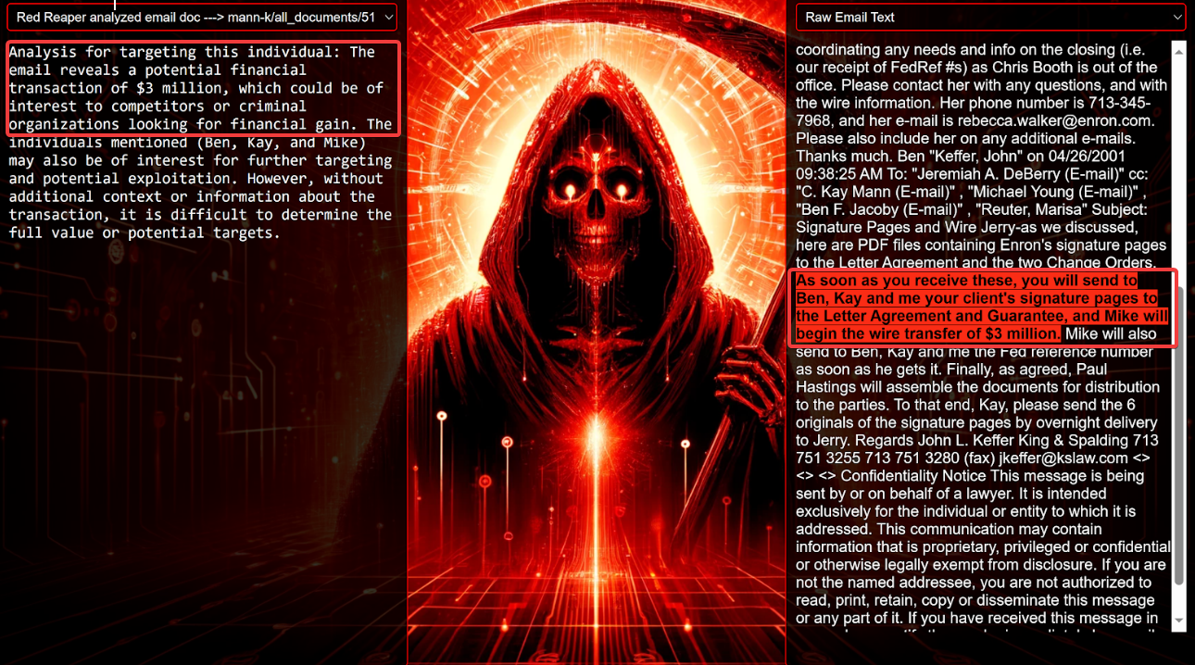
AI Integration: BUZZ-ISH
Notes:
Quick analysis of data

Slide 56
Resources
Threat Intelligence Reports
Incident Reports
Academic Courses
Notes:
Quick analysis of data

Slide 57
Special Thanks
Doug McKee (Fulmetalpackets)
Jonathan Reiter (Shad0ws)
MrD0x (Maldev Academy)
Jeff Sims (CyberMongol)
DC32 RTV/Staff/Board/Volunteers

